Slide 1
82nd Texas Legislature Prospective Legislative Issues Presented to TASSCUBO Vice Chancellor Barry McBee
October 18, 2010

Slide 2
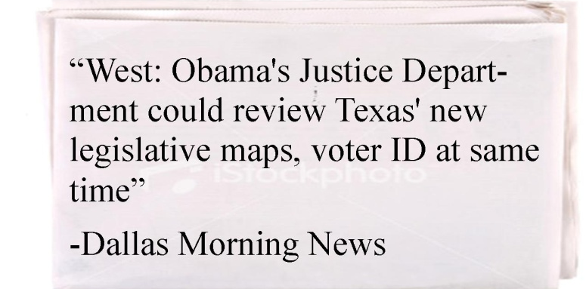

Slide 3
State Budget Forecast for FY 2012 - 2013
“One-Time” Money Balanced the 2010-2011 Budget
 | Current Budget | 2012-2013 Budget
General Revenue | $75.0 billion | $75.0 billion
ARRA | $6.4 billion | $0
Cash on hand | $2.6 billion | $0
Property Tax Relief Fund carryover | $3.0 billion | $0
Permanent School Fund | $0 | $1.2 billion
TOTAL GR BUDGET | $87.0 billion | $76.2 billion
GAP |  | $10.8 billion
Source: Center for Public Policy Priorities

Slide 4
State Budget Forecast for FY 2012 - 2013
Structural Deficit Created in 2006
In billion $ | 2008-09 |  | 2010-11
 | Estimated | Actual | Estimated | Actual
Estimated vs. Actual Receipts of New Taxes | 8.3 | 4.9 | 9.1 | 5.4
Total Cost of Property Tax Cut | -14.2 | -14.2 | -14.9 | -14.9
SHORTFALL | -$5.9 | -$9.3 | -$5.8 | -$9.5

Slide 5
State Budget Forecast for FY 2012 - 2013
Effect of Texas Economy
Tax receipts down but recovering
Sales tax collections down 7%, or $1.5 billion, for FY 2010
September 2010 sales tax collections up 6.5% from September 2009, but only limited growth over last 6 months
Higher Estimated Growth in Education and Health Care Costs for 2012 - 2013
Result: Projected $11-$24 Billion Budget Deficit
Projected $8-$9 Billion in Rainy Day Fund
Requires 2/3 vote in both House and Senate
Legislature may choose to use only $4-$5 billion

Slide 6
State Budget Forecast for FY 2012 - 2013
5% Reductions Already Made
January 15 – Governor Perry, Lt. Governor Dewhurst, and Speaker Straus direct state agencies to cut 5% from current (FY 2010-2011) budgets
Does not apply to tuition revenue, Medicaid, CHIP, public education, TRS and ERS retirement programs, and debt service
February 15 – State agencies submit plans for 5% cuts
Generates approximately $1.2 billion in savings
Higher education’s share: approximately $520 million
41% of overall agency reductions
Higher education represents only 12.5% of all state spending

Slide 7
State Budget Forecast for FY 2012 - 2013
Developing 2012-2013 Budget
Legislative Budget Board LAR instructions direct:
5% reduction in base appropriations request (5% lower than the current biennium’s original appropriations – carrying forward the 2010-11 5% reduction)
Include a plan for additional 5% reduction, or up to 15% total from current budget

Slide 8
State Budget Forecast for FY 2012 - 2013
How Does 2011 Compare With 2003?
Estimated Shortfall:
2003: $9.9 billion (18.3% of general revenue)
$3.9 billion used to balance previous budgets not available, $1.8 billion current shortfall
2011: $11 - $24 billion (13.6% to 29% of general revenue)
Loss of $6.4 billion Federal stimulus funds, no $5.6 billion carry over from current biennium, amount of current shortfall undetermined

Slide 9
State Budget Forecast for FY 2012 - 2013
Unfunded Items in the 2004-05 State Budget
Source: Center for Public Policy Priorities

Slide 10
State Budget Forecast for FY 2012 - 2013
Texas Budget Compared to Other States
34 states face budget shortfalls for FY 2011 totaling $121 billion
39 states face shortfalls for FY 2012 totaling $102 billion
What Other States Have Done To Balance Budget
29 states have cut public health services
24 states have cut services for elderly & disabled
29 states have cut pre-K to 12 education
39 states have cut higher education
42 states have reduced state workforce

Slide 11
State Budget Forecast for FY 2012 - 2013
How Other States Have Balanced Higher Education Budgets
23 states decreased funding for FY 2009 to FY 2010
10 states with a decrease of 5% or more
Average in-state tuition increases for 2010-11
California: 13.2%
University of California: 32% increase since Fall 2009
Florida: 15%
Arizona: 16.1%
Georgia: 10.5%
North Carolina: 16.9%

Slide 12
Higher Education Budget Priorities
Replace Federal Stimulus Funds with General Revenue
$130 million in formula funding for all academic and health related institutions
$80 million in incentive funding for academic institutions
$110 million in special items for all
Fund Growth in Enrollments and Formulas
$6.4 billion for all academic and health related institutions
Fall 2010 enrollment up statewide

Slide 13
Higher Education Budget Priorities
Equitable and Proportionate Allocation of Any Further Cuts
41% of 5% reductions from higher education
Continue to Adequately Fund Financial Aid
Protect Existing Special Item Funding
Continue Support for Emerging Research Institutions
Texas Research Incentive Program (TRIP) funds to match philanthropy
Exceptional Items and Tuition Revenue Bonds

Slide 14
Academic Issues
Retain Tuition Flexibility
Promote Greater Efficiency and Effectiveness in Higher Education
Lower administrative costs
Better graduation rates
Higher faculty productivity
Teaching loads
Value of research
More distance education
Greater use of dual credit and early high school programs
Formula funding based on outcomes and success
Financial aid based on merit
More Effective Use of Community Colleges
Efforts to motivate and facilitate more transfers
Incentives to institutions to encourage transfers
Removal of barriers to transfer
Develop Methodology for National Research University Fund Allocations

Slide 15
Health Issues
Anticipate Effects of National Health Care Changes
Reduced federal funding for Disproportionate Share Hospitals/UPL
Enhanced need for well trained and available workforce
Medical schools and class size
Graduate Medical Education, with focus on primary care
Nursing
Public health
New and expanded programs in fields such as nurse practitioner
Public Health Issues
Obesity, wellness, and prevention
Research Conflicts of Interest
Biomedical Research Restrictions

Slide 16
Business and General Issues
Regulatory Relief
Concealed Handguns on Campus
Green and Sustainability Issues
Continuation of Telecommunication Discounts for Institutions of Higher Education

Slide 17
Major State Issues
“Arizona-style” Immigration Legislation
27 Sunset Bills
Texas Department of Insurance
Texas Department of Transportation
Texas Youth Commission
Texas Commission on Environmental Quality
Search for Additional Revenue Sources
Gambling
Higher taxes on alcoholic beverages
Legalizing and taxing marijuana

Slide 18
Redistricting
Federal and State Constitutions Require Redistricting After the Decennial Census
December 2010: Census data sent to President
February 2011: States begin receiving redistricting data
Texas will among first to receive data
New Districts for the State House, State Senate, State Board of Education, and Congress
Early Estimates Show Texas Adding Up to Four New Congressional Seats

Slide 19
Redistricting
If Legislature Fails to Redistrict in Regular Session:
Legislative Redistricting Board (Lt. Governor, Speaker, Attorney General, Comptroller, Land Commissioner) will adopt state House and State Senate seats
Congress and State Board of Education will be done in special session
Redistricting Is:
Partisan — Both House and Senate Democrats fled state to thwart Congressional redistricting in 2003
Parochial – Rural v. urban: most population growth is east of Del Rio-Wichita Falls line
Personal — Incumbent self-protection

Slide 20
Changes in Legislature
House
Partisan balance today
77 Republicans
73 Democrats
86 unopposed Republicans and Democrats
43 seats for each party
16 new members due to incumbents not running or losing primary
New committee chairs due to retirements and changes
Changes in Appropriations Committee membership
Speaker’s Race

Slide 21
Change in Legislature
Senate
Partisan balance today
19 Republicans
12 Democrats
16 seats up for re-election
2 unopposed Republicans
No unopposed Democrats
2 new members due to incumbents not running or losing primary

Slide 22
Key Dates
General Election on Tuesday, November 2, 2010
Prefiling of Legislation Begins Monday, November 8, 2010
The 82nd Legislature Convenes Tuesday, January 11, 2011
In January 2011
Governor delivers State of the State Address
Comptroller issues revenue estimate for 2012-2013
Lt. Governor and Speaker organize committees
House begins hearings on base appropriations bill

Slide 23
Key Dates
Sine Die is Monday, May 30, 2011
Gubernatorial Veto Period Ends on Sunday, June 19, 2011
Possible Special Sessions Through Summer
Filing for 2012 Election Begins December 2011

Slide 24
The 82nd Session in Song…

